Slide 1
HDMI to VGA Converter
Naoaki Takatsu
CECS 461
May 14, 2019

Slide 2
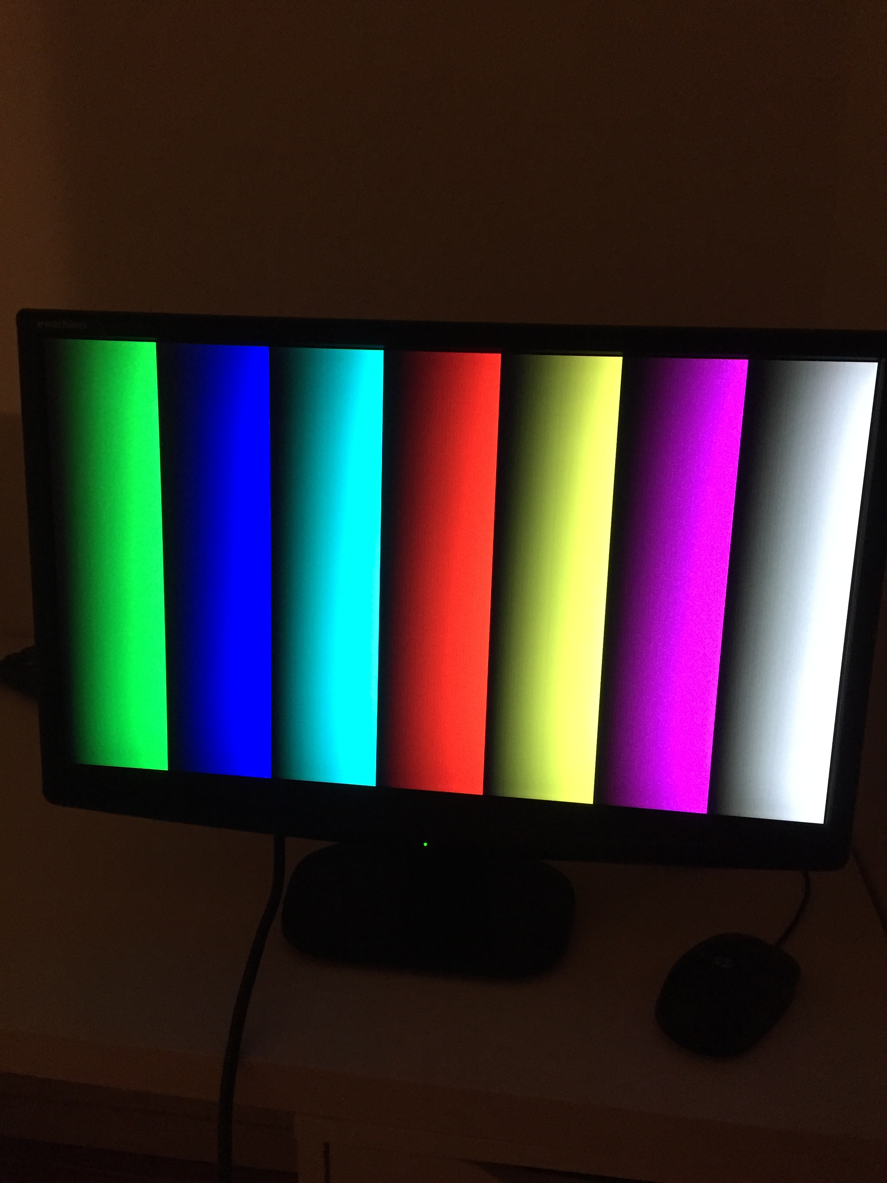
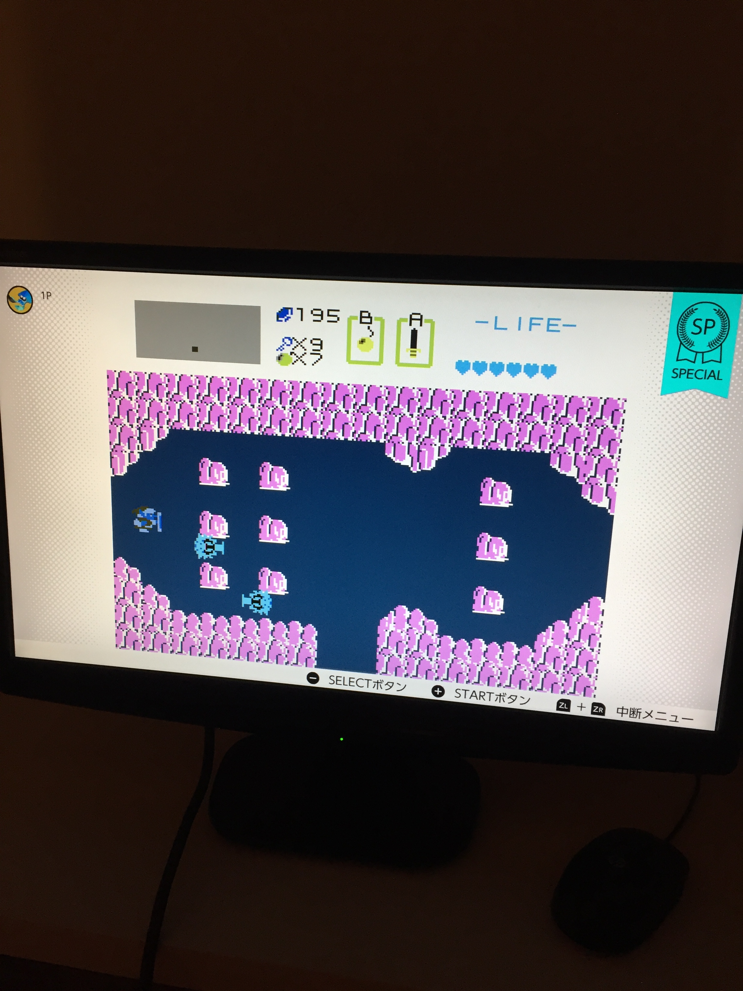
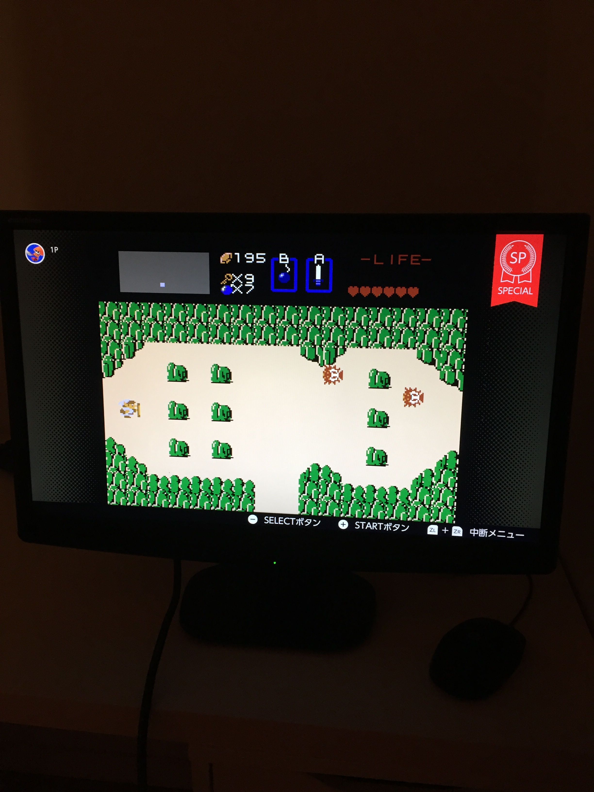
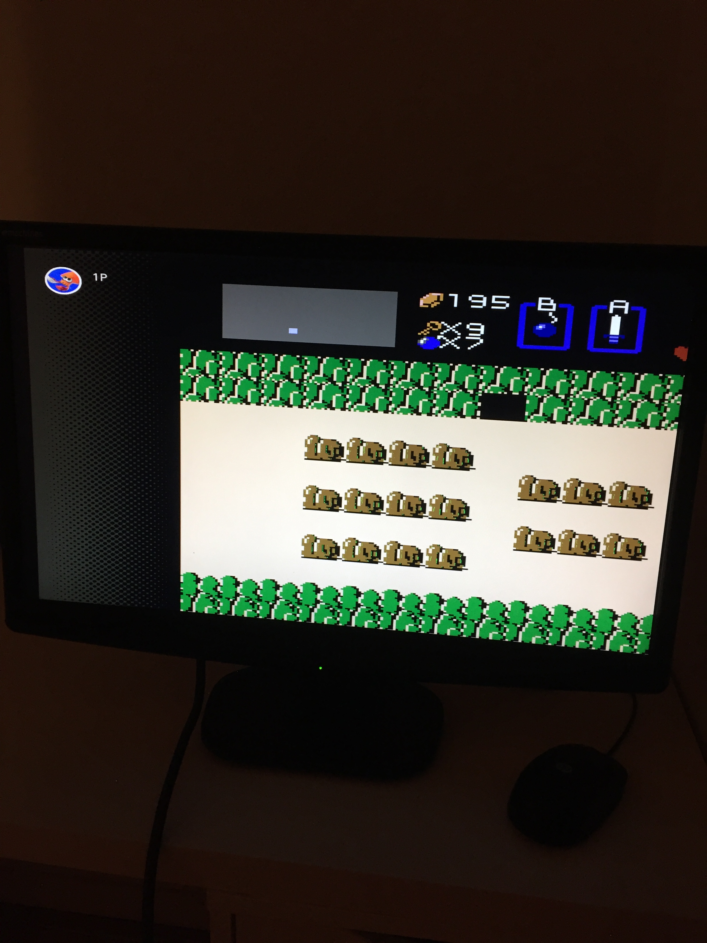
Features
Supports HDMI display resolution of:
640x480, 800x600, 1280x720, 1280x1024, and1920x1080
Print color bar test screen to cover up display
Color inverting screenshot
Stop/resume streaming
Frame rate of 60 FPS

Slide 3
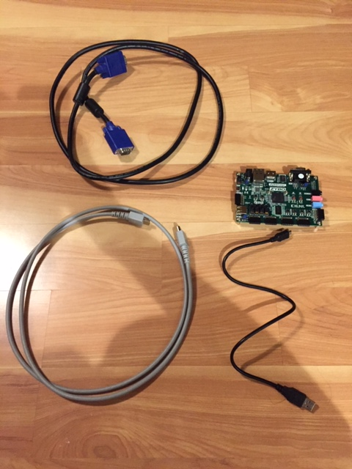
Materials needed
Zybo board
Micro USB to USB cable
HDMI cable
VGA cable
HDMI source
VGA output device

Slide 4
Operation
1. Establish UART connection and open serial terminal.
2. Program FPGA to Zybo board and run the software application as GDB in Xilinx SDK.
3. Connect HDMI and VGA cables respectively from source to board.
4. View serial terminal for available options and press respective button to execute one of the following:
5. Enter one of the following dip switch values to change the HDMI display resolution:
Push Button | Menu
0 | Pause/resume stream
1 | Capture frame and invert color/resume stream with original color
2 | Change display resolution with respect to dip switch value
3 | Display/hide color bar test screen to hide stream
Dip Switch Value | HDMI Resolution
1 | 640x480
2 | 800x600
3 | 1280x720
4 | 1280x1024
5 | 1920x1080
0 | No change
Other | Display error message

Slide 5
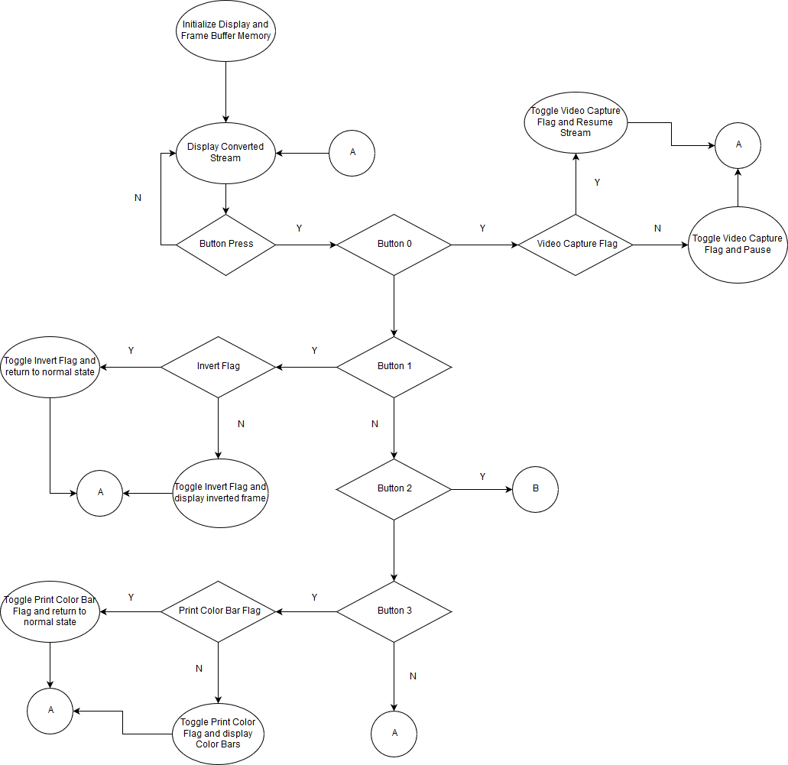
Software flowchart
For initialization and push button

Slide 6
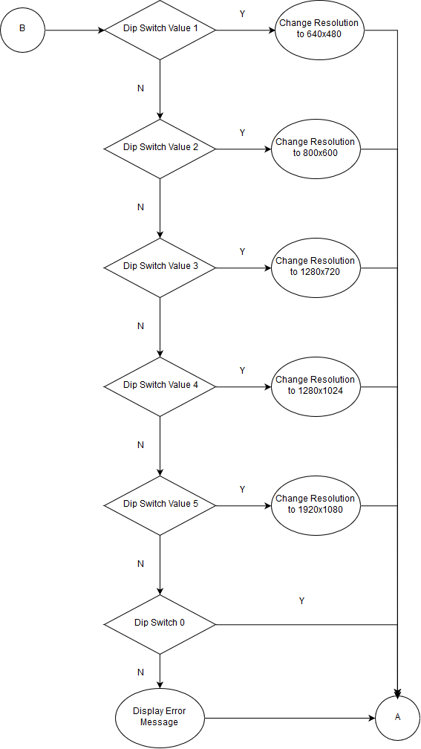
Software flowchart
For Dip switch

Slide 7
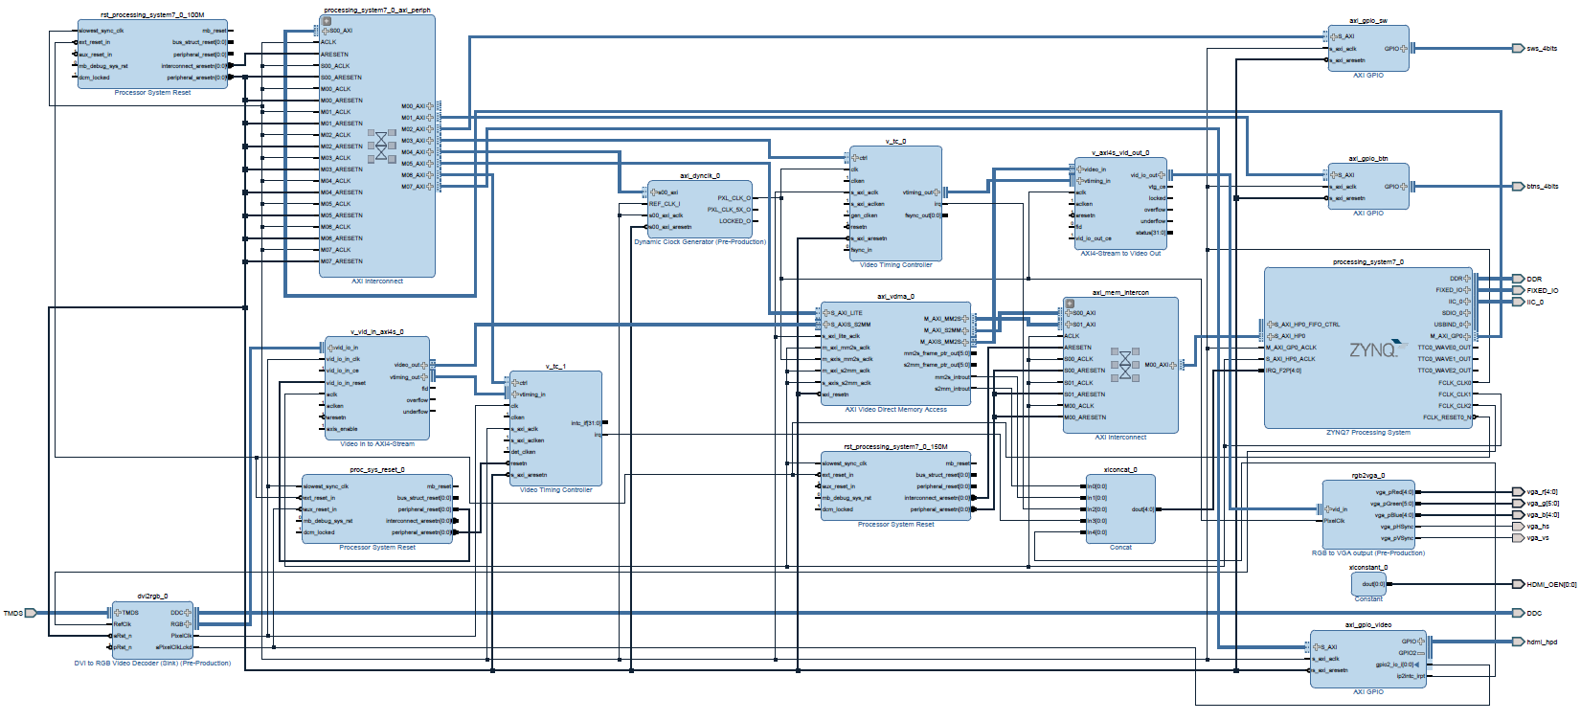
Dip Switch
Pass AXI4 Stream Data as RGB Data
Control Video Timing for VGA
Push Button
Control Video Timing Dynamically
Pass RGB Data as AXI4 Stream Data
Save Video Frames to Internal Memory
Pass RGB Data as VGA Output
Control Video Timing for HDMI
Convert HDMI to RGB Data
Concatenate Interrupt Requests
HDMI Output Enable
Hardware Block Diagram
Hotplug for HDMI

Slide 8
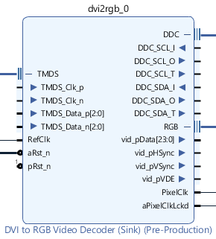
Dvi to rgb video decoder Block
TMDS – Transition-Minimized Differential Signaling, DVI/HDMI data input
DDC – Display Data Channel, provides digital communication between computer display and graphics adapter
RGB – Red Green Blue, Pixel Data including color and timing data

Slide 9
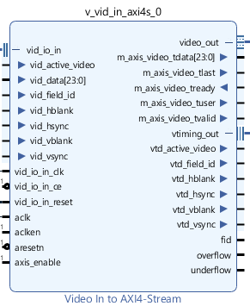
Video In to axi4-stream Block
vid_io_in – RGB display and timing data input
video_out – video display output
vtiming_out – video timing output

Slide 10
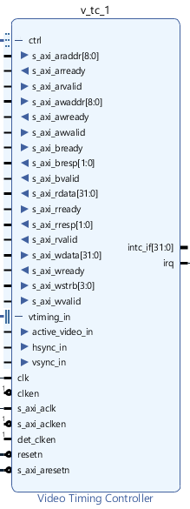
Video Timing controller (HDMI) block
ctrl – s_axi data
vtiming_in – video timing input
irq – interrupt request signal

Slide 11
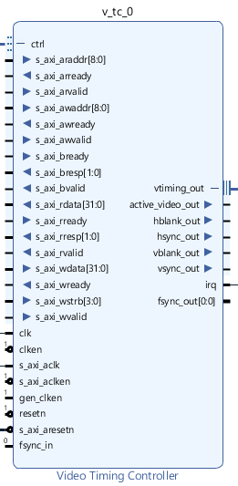
Video Timing controller (VGA) block
ctrl – s_axi data
vtiming_out – video timing output
irq – interrupt request signal

Slide 12
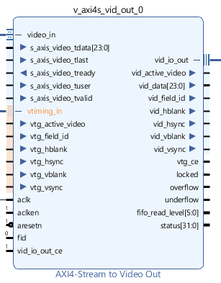
Axi4-stream to video out block
video_in – input display data from AXI interconnect
vtiming_in – input timing data from VGA timing block
vid_io_out – converted RGB data output

Slide 13
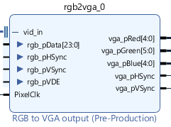
RGB to vga output block
vid_in – Converted RGB data
PixelClk – pixel clock input from dynamic clock generator
Vga_pXX – VGA color and timing output data

Slide 14
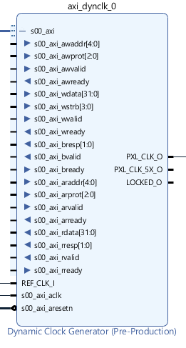
Dynamic clock generator block
s00_axi – AXI interface pin
PXL_CLK_O – pixel clock output for VGA

Slide 15
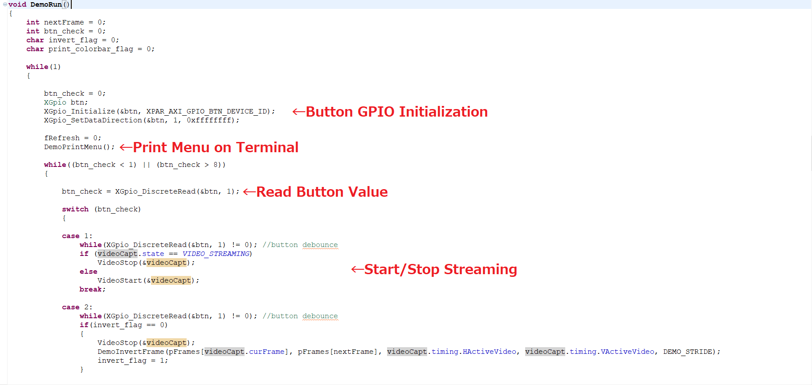
Source Codes

Slide 16
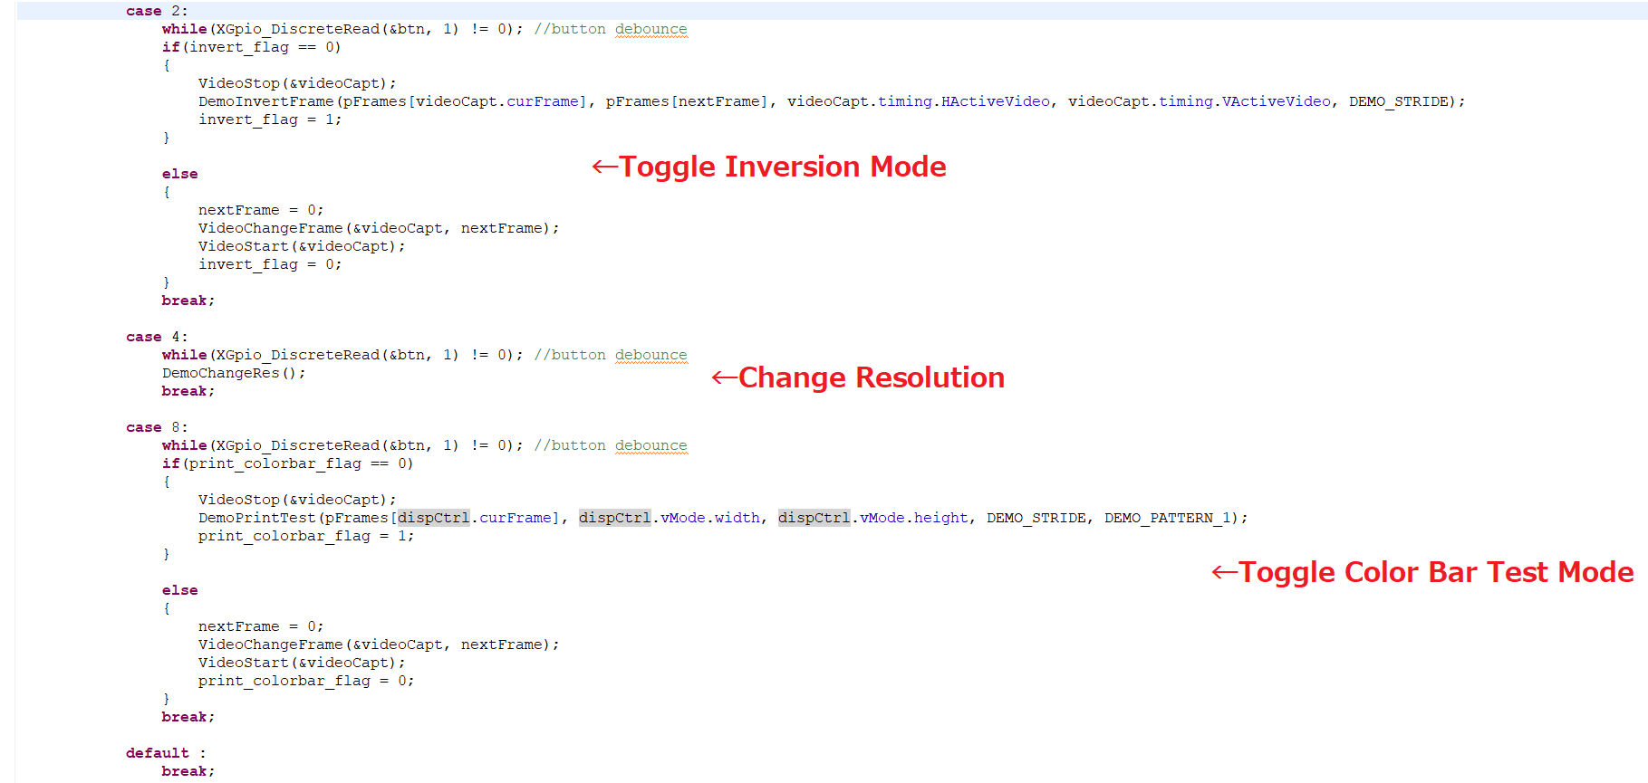
Source Codes

Slide 17
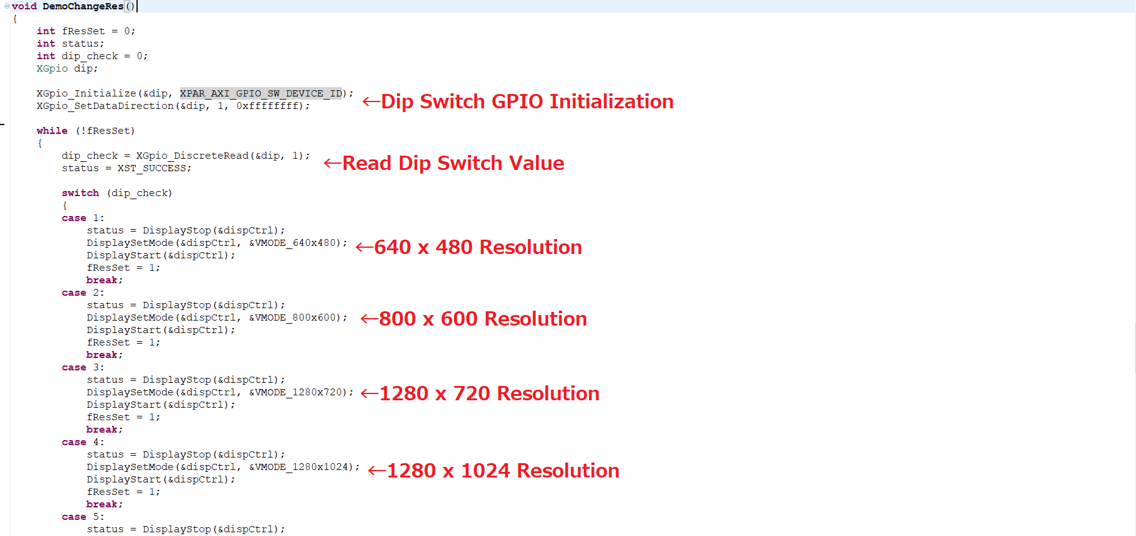
Source Codes

Slide 18
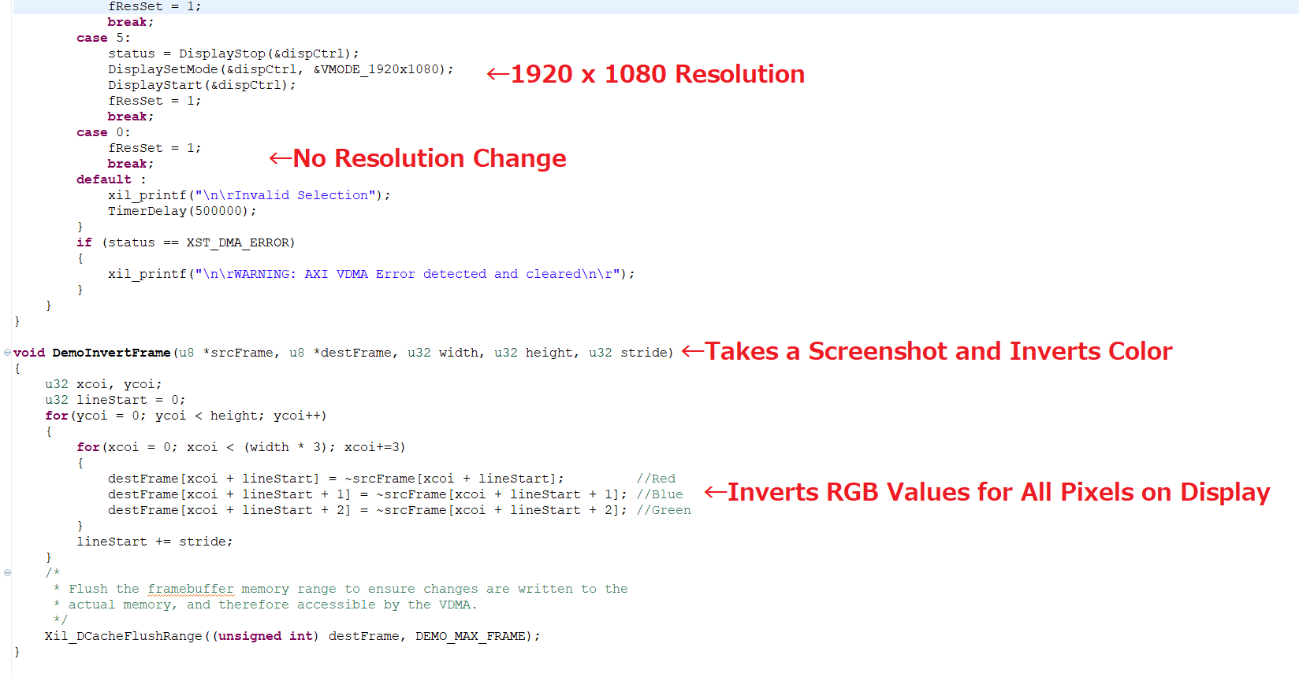
Source Codes

Slide 19
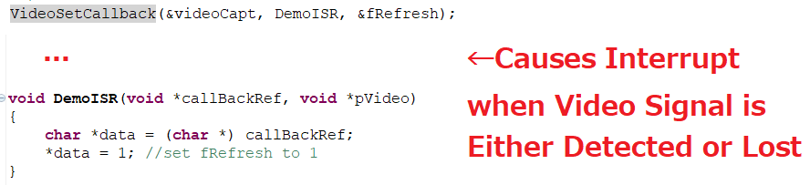
Source Codes

Slide 20
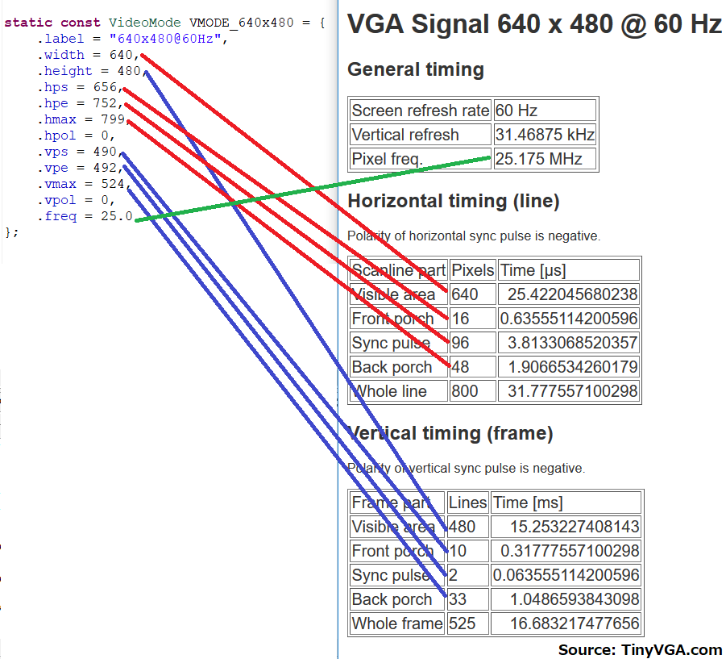
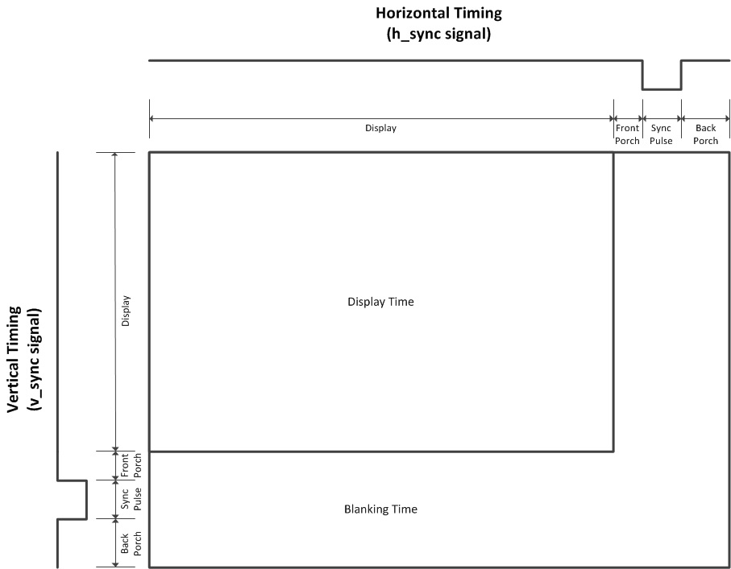
VGA Timing

Slide 21
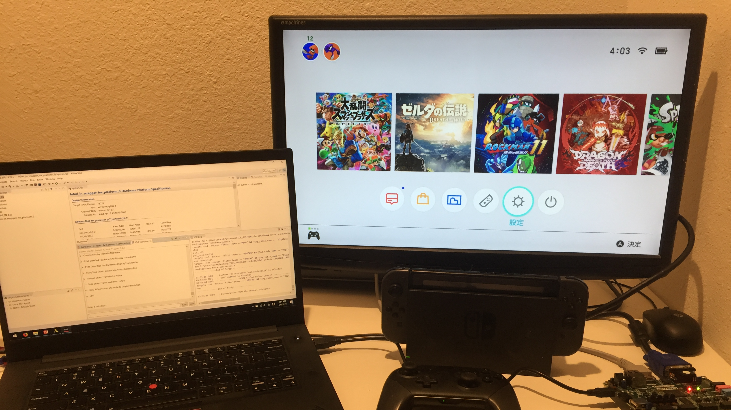
Working Project

Slide 22
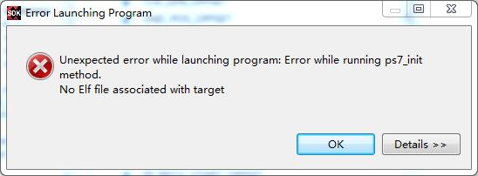
Error
When attempting to run GDB on SDK from Vivado 2016.4, the error shown on the right has always showed up
This error has caused me to transition my project from Vivado 2016.4 to 2018.3 and vice-versa multitude of times

Slide 23
Stuck between a rock and a hard place
The HDMI input demo on the Digilent website is meant to be built on Vivado 2016.4 edition
However, due to the previously stated error, I needed to download the 2018.3 edition HDMI input project from the forums
The project works fine, but the console outputs tons of error due to outdated BSP
In addition to that, all modifications made on the application software were ignored upon running with GDB
After recompiling the whole hardware in Vivado, creating a brand new BSP, and replicating original C code on the application software, all the error messages have disappeared
Despite of having no more error messages, now the HDMI feed wasn’t being displayed on the monitor
Looking through tons of HDMI references, assuming that the issue was on either the hardware or software side, has given me a good amount of sleepless nights

Slide 24
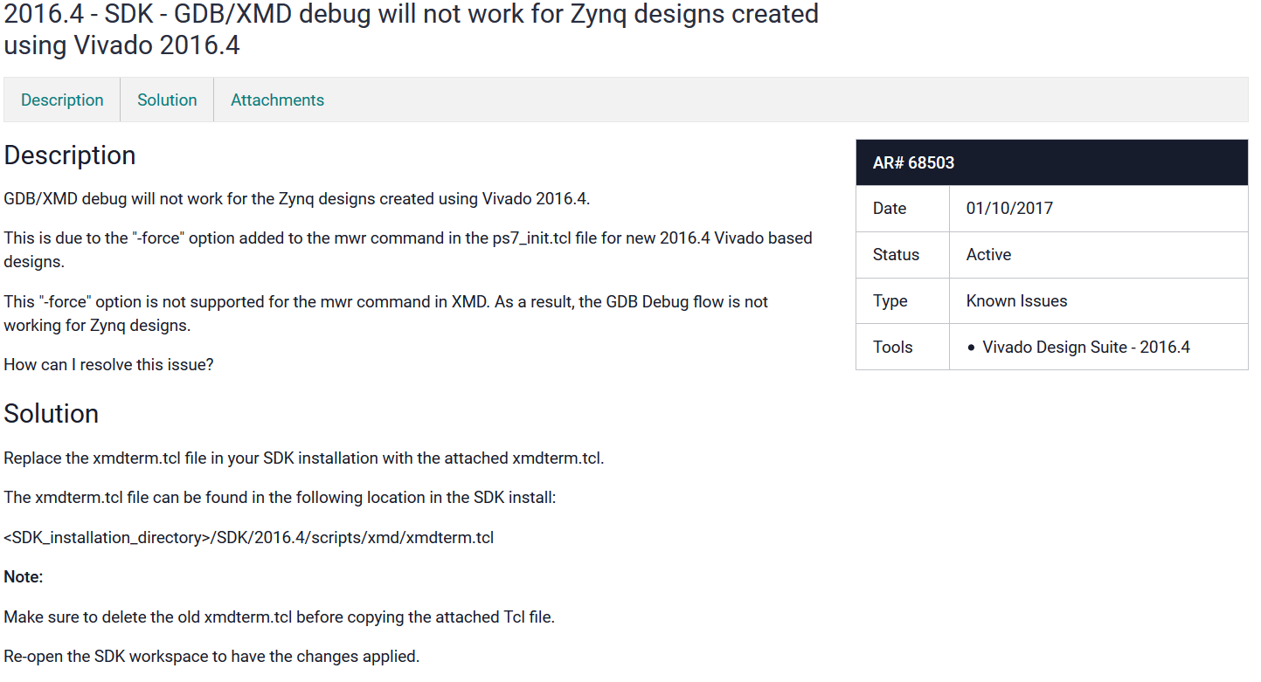
Error solved!
After spending days of trial and error, debugging, and researching, I have finally managed to find a forum with a working solution
The error was caused due to missing “-force” option in the Vivado 2016.4 edition
Simply downloading and replacing the xmdterm.tcl in the SDK installation folder has solve this problem

Slide 25
Future plans
Continue streaming while color filter is turned on
Take screenshot/footage and save it to micro SD card
Pull HDMI audio source to headphone jack

Slide 26
References
-Digilent forums
-Tutorial: How to start a video processing application with Vivado VHDL
-Video Processing Using VHDL and ZYBO Board
-tinyvga.com/vga-timing
-http://marsee101.blog19.fc2.com

Slide 27
Thank you

